Slide 1
Dynamic Programming

Slide 2
Fibonacci Numbers
The series: 0 1 1 2 3 5 8 13 21…
Fib(n) = Fib(n-1) + Fib(n-2)
A simple recursive implementation
int fib(int n) { if (n <= 1) return n; return fib(n - 1) + fib(n - 2); }

Slide 3
Fibonacci Numbers
Any problem with the previous solution approach?
Something to do with complexity!

Slide 4
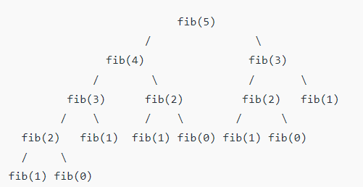
Fibonacci Numbers

Slide 5
Complexity (Recursive Solution)
The highest depth of the recursion tree will be n.
For a complete binary tree of height h, have 2^h – 1 node.
It is an exponential runtime

Slide 6
Memoization
Store the results of the subproblems (creating a table or memo)
Instead of computing the subproblems every time, if it is calculated before, lookup in the memo and return
memo
-1 | -1 | -1 | -1 | -1 | -1 | -1 | -1
int fib(int n) { if(memo[n] !=-1) return memo[n] if (n <= 1){ res = n; else res = fib(n - 1) + fib(n - 2); memo[n] = res; return res; }

Slide 7
Memoization (Top Down Approach)
memo
-1 | -1 | -1 | -1 | -1 | -1 | -1 | -1
set
0 | 0 | 0 | 0 | 0 | 0 | 0 | 0
int fib(int n) { if(set[n]) return memo[n] if (n <= 1){ res = n; else res = fib(n - 1) + fib(n - 2); memo[n] = res; set[n] = 1; return res; }

Slide 8
Bottom up approach (Tabulation)
memo
-1 | -1 | -1 | -1 | -1 | -1 | -1 | -1
int fib(int n) { if (n <= 1){ return = memo[n]; for(int i=2; i<=n; i++) memo[n] = memo[n-1]+ memo[n – 2]; return memo[n]; }

Slide 9
Bottom up approach (Tabulation)
memo
0 | 1 | -1 | -1 | -1 | -1 | -1 | -1
int fib(int n) { if (n <= 1){ return = memo[n]; for(int i=2; i<=n; i++) memo[n] = memo[n-1]+ memo[n – 2]; return memo[n]; }

Slide 10
Bottom up approach (Tabulation)
memo
0 | 1 | -1 | -1 | -1 | -1 | -1 | -1
memo[0] = 0; memo[1] = 1; int fib(int n) { if (n <= 1){ return = memo[n]; for(int i=2; i<=n; i++) memo[n] = memo[n-1]+ memo[n – 2]; return memo[n]; }

Slide 11
Complexity (DP)
Fill-up the DP table by calculating each value only once
Total Time needed: N * Time required combine the pre-calculated results
For Fibonacci Problem: Combining takes constant time.
So overall Complexity: O(N)

Slide 12
Friends Pairing Problem
Given n friends, each one can remain single or can be paired up with some other friend.
Each friend can be paired only once.
Find out the total number of ways in which friends can remain single or can be paired up.

Slide 13
Friends Pairing Problem
Input : n = 3
Output : 4
Explanation:
{1}, {2}, {3}
{1, 2}, {3}
{2}, {1, 3}
{1}, {2, 3}

Slide 14
Friends Pairing Problem
Input : n = 4
Output : 10
Explanation:
When 4 remains alone: {1}, {2}, {3} - {4} {1, 2}, {3} - {4} {2}, {1, 3} - {4} {1}, {2, 3} - {4} | When 4 paris with someone: (i.e 1) {2}, {3} - {4,1} {2,3} - {4,1} How many options 4 have like this? 3

Slide 15
Friends Pairing Problem
Find smaller sub problem

Slide 16
Friends Pairing Problem
Total number of ways to make friends with n people:
N^{th} person may decide to remain single
Or
N^{th} person may decide to pair up with remaining (n-1) person
For 1st choice: Solution is same as solution for (n-1) person
For 2nd choice: N^{th} person will have (n-1) choice to pair up
For each choice, there are remaining (n-2) people

Slide 17
Friends Pairing Problem
Find smaller sub problem
f(n) = f(n – 1) + (n – 1) * f(n – 2)

Slide 18
Complexity
Similar to Fibonacci series

Slide 19
Tiling Problem (V1)
We have 2x1 unlimited supply of tiles
Have to cover a 2xn sized board without overlapping
Calculate total ways we can tile

Slide 20
Tiling Problem (V1)
If n = 3
1 | 2 | 3
1 | 2 | 3
1 | 1 | 3
2 | 2 | 3
1 | 2 | 2
1 | 3 | 3

Slide 21
Tiling Problem (V1)
If n = 4
1 | 2 | 3 | 4
1 | 2 | 3 | 4
1 | 1 | 3 | 3
2 | 2 | 4 | 4
1 | 1 | 3 | 4
2 | 2 | 3 | 4
1 | 2 | 2 | 4
1 | 3 | 3 | 4
1 | 2 | 3 | 3
1 | 2 | 4 | 4

Slide 22
Tiling Problem (V1)
Recurrence relation?

Slide 23
Tiling Problem (V1)
First tile placed vertically:
Remaining size to tile?
First tile placed horizontally: (Another tile must be placed horizontally below):
Remaining size to tile ?

Slide 24
Tiling Problem (V1)
First tile placed vertically:
Remaining size to tile is n-1
First tile placed horizontally: (Another tile must be placed horizontally below):
Remaining size to tile: n-2
f(n) = f(n-1) + f(n-2)

Slide 25
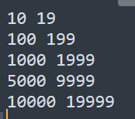
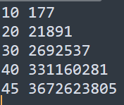
Performance Comparison
With DP table
Without DP table

